Slide 1
Software Architectures Assignment 1 : Enterprise Resource Planning System
Harmalkar Rahul Rajan Sayali
ID No.: 2024TM93073

Slide 2
Purpose of the System
ERP System:
The ERP (Enterprise Resource Planning) system is designed to streamline and integrate various business processes across the organization. It provides a unified platform to manage key functions such as finance, human resources, supply chain, procurement, and customer relationship management (CRM).
Key Benefits:
Improved Efficiency: By centralizing data and automating routine tasks, the system minimizes manual work and reduces the likelihood of errors.
Real-time Information: Enables real-time data access, facilitating better decision-making by providing accurate and timely insights.
Scalability: As the organization grows, the ERP system can scale with it, supporting new functions or expanded operations.
Cross-departmental Collaboration: Encourages collaboration across departments (like OIC) by providing a shared view of data and operations.

Slide 3
Key Requirements
Functional Requirements:
User Management:
Authentication and authorization for different user roles (e.g., Admin, Manager, Employee).
Role-based access control to various modules and data.
Finance Management:
General ledger, accounts payable, accounts receivable, and financial reporting.
Integration with banking systems for transaction processing.
Human Resources:
Employee data management, payroll processing, and benefits administration.
Recruitment and onboarding processes.
Supply Chain Management:
Inventory management, procurement, and order processing.
Supplier and vendor management, including contracts and performance tracking.
Customer Relationship Management (CRM):
Customer data management, sales tracking, and support ticketing.
Integration with marketing tools and customer feedback systems.
Reporting and Analytics:
Dashboards and reporting tools for business intelligence and performance tracking.
Customizable reports for different departments and stakeholders.
Non-functional Requirements:
Performance:
System must handle concurrent users efficiently with minimal latency.
Response times for user interactions should meet predefined standards.
Scalability:
Ability to scale horizontally or vertically to accommodate growth in data volume and user load.
Support for additional modules or features as needed.
Security:
Data encryption both at rest and in transit.
Regular security updates and vulnerability assessments.
Reliability:
High availability with minimal downtime.
Regular backups and disaster recovery plans.
Usability:
Intuitive user interface with easy navigation.
Comprehensive documentation and support resources.
Compliance:
Adherence to industry standards and regulations (e.g., GDPR, HIPAA).
Regular audits to ensure compliance.

Slide 4
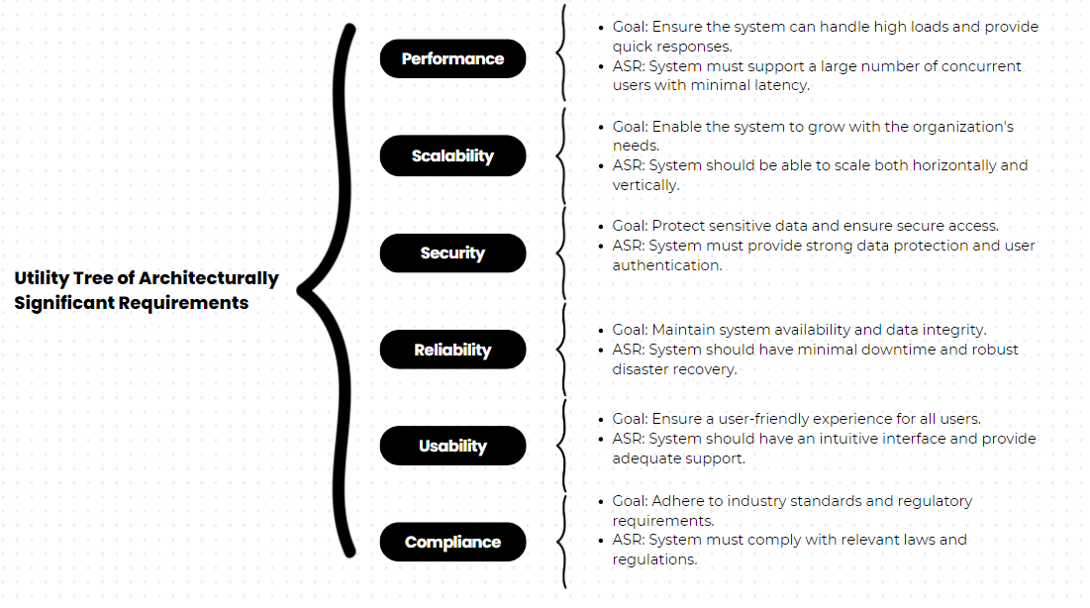
Utility tree of ASR

Slide 5
Tactics to Achieve Top 5 ASRs
1. Performance
Load Balancing: Distributes traffic across servers to avoid overload.
Caching: Stores frequent data in memory for faster access.
Database Optimization: Efficient indexing and query tuning to boost performance.
2. Scalability
Modular Architecture: Independent modules that scale separately.
Microservices: Services scaled individually, reducing bottlenecks.
Distributed Databases: Spreads data across servers for faster access during high load.
3. Security
Data Encryption: Protects data at rest and in transit.
Role-Based Access Control (RBAC): Restricts access based on user roles.
Security Updates: Regular patches to prevent vulnerabilities.
4. Reliability
Redundant Systems: Backup components to reduce downtime.
Automated Backups: Regular backups for data recovery.
Failover Mechanisms: Switch to backup systems during failure.
5. Usability
User-Centered Design: Intuitive interfaces for better user experience.
Documentation: Guides to help users navigate the system.
Training: Programs to boost user proficiency.

Slide 6
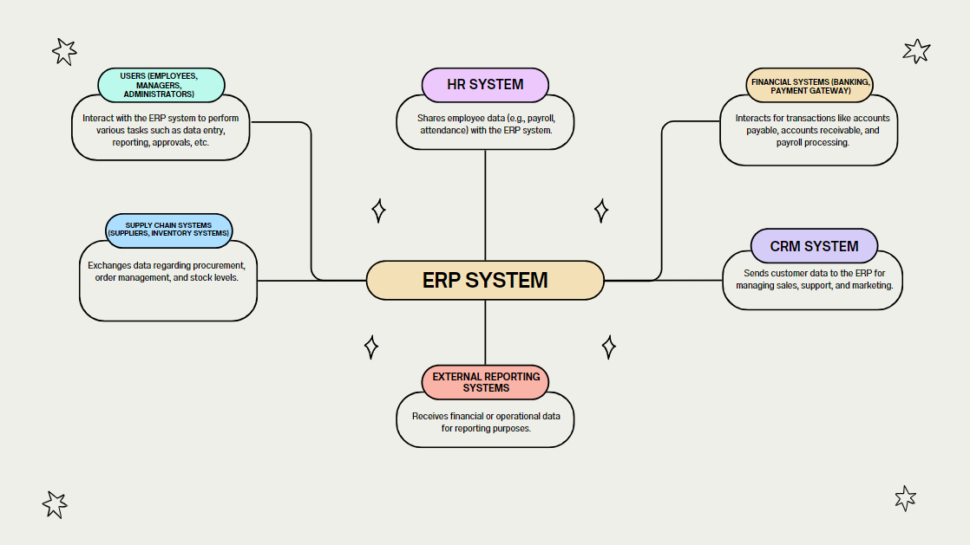
Context diagram

Slide 7
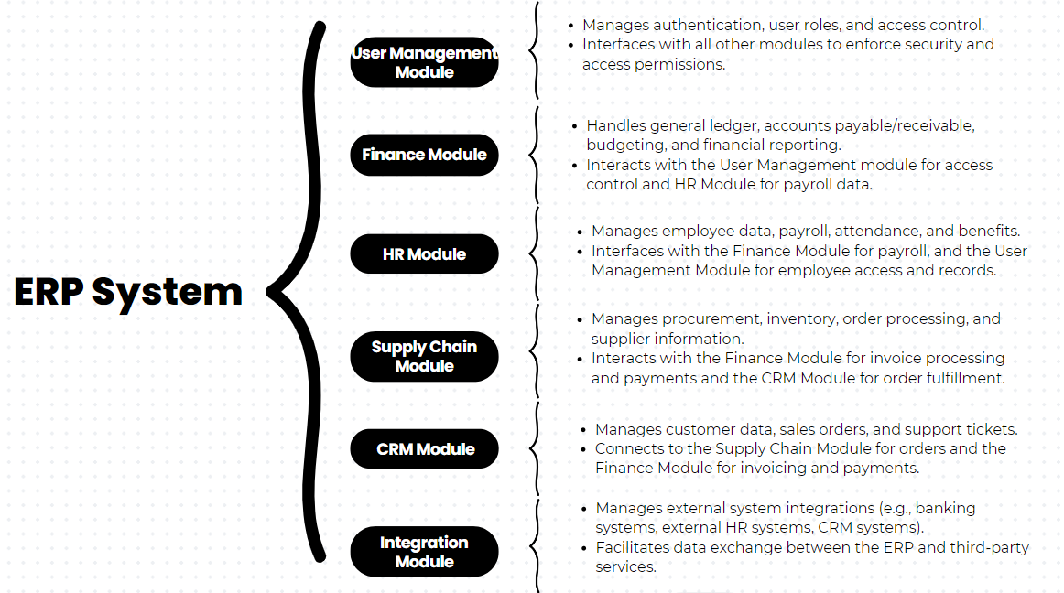
Module decomposition

Slide 8
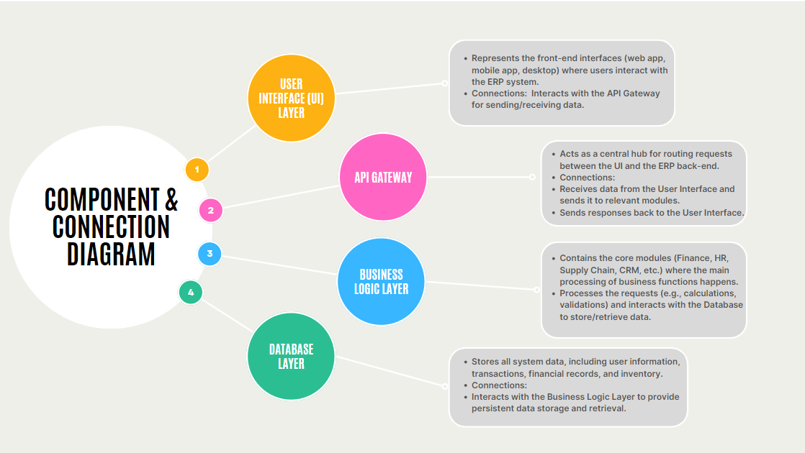
Component & Connection diagram

Slide 9
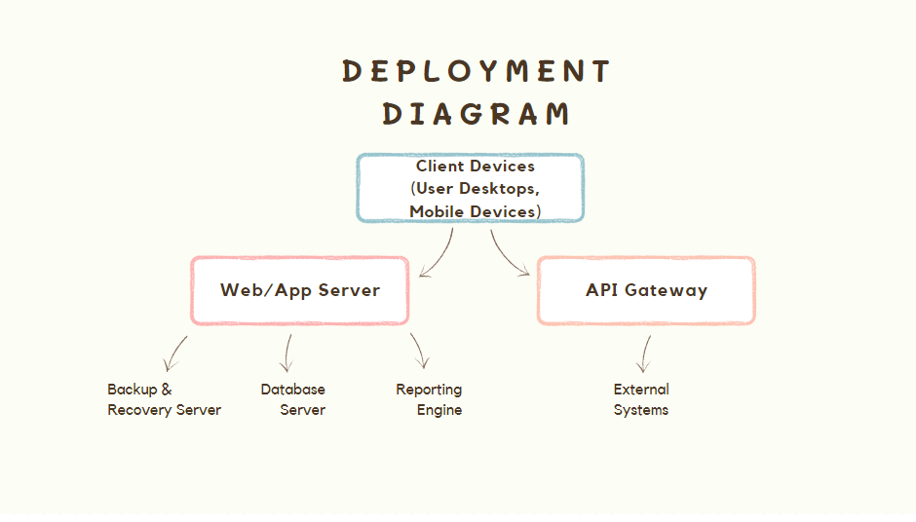
Deployment diagram

Slide 10
System Description
The ERP system at Trinamix INC is a comprehensive solution designed to manage and integrate the
company's core business processes. It consists of several key modules including Finance, Human
Resources, Supply Chain, and Customer Relationship Management (CRM), all of which work together to
provide a centralized platform for managing data and operations across the organization.
Key Components and Functionality:
User Interaction: Users (employees, managers, and administrators) access the system through web or mobile interfaces to perform tasks such as data entry, report generation, and approval workflows.
Business Logic Layer: The system processes user requests through various modules:
Finance Module: Manages accounting, payroll, budgeting, and financial reporting.
HR Module: Handles employee data, payroll, attendance, and benefits.
Supply Chain Module: Oversees procurement, inventory, and supplier management.
CRM Module: Manages customer data, sales orders, and support requests.
Database: A central database stores all ERP data, ensuring real-time access for all departments, facilitating coordination between finance, HR, and supply chain.
Integration: The system communicates with external services (banking, payroll, CRM systems) through an API Gateway for seamless operations.
Reporting Engine: Provides customizable reports and dashboards, allowing users to generate insights and track performance.
Backup & Recovery: Data is regularly backed up to ensure minimal downtime and business continuity in case of system failures.

Slide 11
Key Learnings
Understanding Software Architecture: I learned how different components in an ERP system (such as the web server, business logic, and database) work together to provide seamless business operations, focusing on how the architecture ensures performance, scalability, and reliability.
Importance of Architecturally Significant Requirements (ASRs): By exploring performance, scalability, security, and usability as key ASRs, I gained insights into how these non-functional requirements shape the design of software systems to meet business needs.
Role of Tactics in Achieving System Goals: The use of tactics like caching for performance, role-based access control for security, and modular architecture for scalability illustrated how specific design decisions address system challenges.
System Deployment and Data Flow: The deployment diagram and component interactions highlighted the importance of how physical infrastructure (like servers, databases, and client devices) supports the software system’s functionality.
Centralized Data Management: I gained an appreciation for how centralized data storage in an ERP system allows for real-time access across departments, improving collaboration and decision-making within an organization.
External System Integration: The study of APIs and external system integration (such as banking and CRM systems) demonstrated how ERP systems extend their functionality and communicate with third-party services, enhancing business flexibility.

Slide 12


